Slide 1
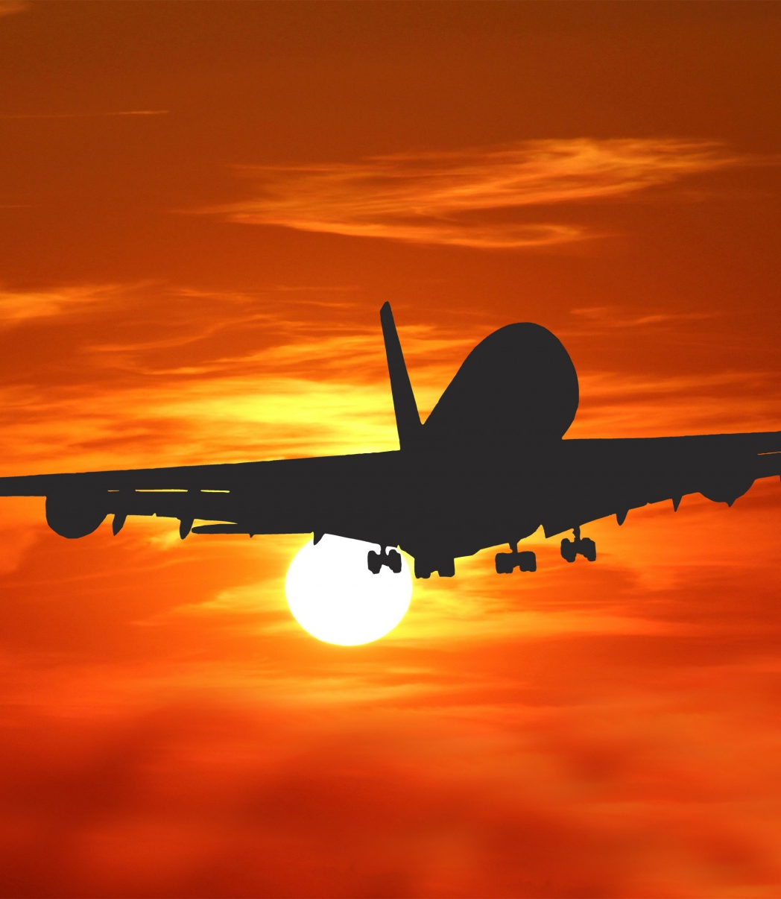


Unlocking the Potential of Data: Driving Business Growth in the Aviation Industry FY14-15
Sethuraman B

Slide 2
Agenda
Introduction
Analysis
Primary goals
Summary
Areas of growth

Slide 3

Interpreting and Leveraging Data to Drive Strategic Growth for the Company
where is the airline losing the most money?
where they are most profitable?
and
whether should add a Chicago to Atlanta route?
3

Slide 4


Primary goals
grow and position
in
the market

Slide 5
Areas of growth
5

Slide 6
NPV, IRR AND PAYBACK OF THE NEW ATLANTA DESTINATIONS
IRR is a measure of the profitability of a project or investment
An IRR that is greater expected to generate a positive net present value
IRR is often used as a decision-making tool
Duration, payback is 4 years
6

Slide 7
Revenue Analysis Aircraft
7

Slide 8
Aircraft B737 Seat Capacity 185
B737
$212,073,241.5
Most common type of aircraft
Total Revenue
4459
Number of flights
$5,500
$373.26 / $2.08
Maximum average ticket price
SUM of Fuel cost per mile / Fuel Cost per Seat Mile (Cents)
8

Slide 9
Aircraft A319 Seat Capacity 165
A319
$163,500,230.3
Next common type of aircraft
Total Revenue
3879
Number of flights
$5,500
$271.03 / $1.91
Maximum average ticket price
SUM of Fuel cost per mile / Fuel Cost per Seat Mile (Cents)
9

Slide 10
Aircraft A320 Seat Capacity 181
A320
$59,065,821.45
Least common type of aircraft
Total Revenue
1298
Number of flights
$5,500
$102.37 / $2.02
Maximum average ticket price
SUM of Fuel cost per mile / Fuel Cost per Seat Mile (Cents)
10

Slide 11
11

Slide 12
B737 is the highest fuel cost Highest total revenue by flight are Flight8202 Flight8279 Flight6243 Flight1819
12

Slide 13
Revenue and Number of Flights
13

Slide 14
Revenue and Number of Flights
DESTENATION / Month | JAN | FEB | MAR | APR | MAY | JUN | JUL | AUG | SEP | OCT | NOV | DEC | Grand Total | Revenue %
DCA |  |  |  |  |  |  |  |  |  |  |  |  | 24 | 4.53%
SLC |  |  |  |  |  |  |  |  |  |  |  |  | 36 | 0.41%
IAD |  |  |  |  |  |  |  |  |  |  |  |  | 88 | 1.00%
BWI |  |  |  |  |  |  |  |  |  |  |  |  | 104 | 0.96%
FLL |  |  |  |  |  |  |  |  |  |  |  |  | 148 | 1.74%
DTW |  |  |  |  |  |  |  |  |  |  |  |  | 279 | 1.24%
MSP |  |  |  |  |  |  |  |  |  |  |  |  | 295 | 1.33%
BOS |  |  |  |  |  |  |  |  |  |  |  |  | 315 | 3.68%
PHL |  |  |  |  |  |  |  |  |  |  |  |  | 315 | 3.36%
LGA |  |  |  |  |  |  |  |  |  |  |  |  | 330 | 3.51%
MCO |  |  |  |  |  |  |  |  |  |  |  |  | 353 | 3.47%
EWR |  |  |  |  |  |  |  |  |  |  |  |  | 406 | 3.54%
SEA |  |  |  |  |  |  |  |  |  |  |  |  | 421 | 5.79%
IAH |  |  |  |  |  |  |  |  |  |  |  |  | 446 | 3.50%
MIA |  |  |  |  |  |  |  |  |  |  |  |  | 455 | 5.32%
PHX |  |  |  |  |  |  |  |  |  |  |  |  | 500 | 4.90%
LAS |  |  |  |  |  |  |  |  |  |  |  |  | 503 | 5.39%
CLT |  |  |  |  |  |  |  |  |  |  |  |  | 570 | 2.77%
SFO |  |  |  |  |  |  |  |  |  |  |  |  | 604 | 8.78%
DEN |  |  |  |  |  |  |  |  |  |  |  |  | 614 | 7.24%
JFK |  |  |  |  |  |  |  |  |  |  |  |  | 653 | 6.39%
LAX |  |  |  |  |  |  |  |  |  |  |  |  | 699 | 9.63%
DFW |  |  |  |  |  |  |  |  |  |  |  |  | 716 | 5.55%
ATL |  |  |  |  |  |  |  |  |  |  |  |  | 762 | 5.97%
Grand Total | 709 | 608 | 695 | 683 | 693 | 958 | 1013 | 1025 | 700 | 669 | 989 | 894 | 9636 | 100.00%
14

Slide 15
Simulation of the operation income for the new Atlanta route
Scenario Summary | Current Values: | Baseline | High growth with margin impact | Low Growth with margin impact
Changing Cells:
Revenue Growth Rate | 5.0% | 5.0% | 8.0% | 3.0%
Gross Margin | 40.0% | 40.0% | 45.0% | 32.0%
SG&A Expense as % of Ticket Revenue | 27.5% | 27.5% | 30.0% | 30.0%
Result Cells:
Gross profit | $3,597,885 | $3,597,885 | $4,636,562 | $2,623,590
Operating Income | $1,665,023 | $1,665,023 | $2,221,181 | $701,614
year to year growth increase | 2.0% | 2.0% | 2.0% | 2.0%
15

Slide 16
impact of flight-related costs, such as fuel and labor, on profit per flight for the proposed Chicago-to-Atlanta route
Input Parameters - ORD to ATL
Passengers | 170
Miles | 510
Revenue per Passenger | $150
Cost per Mile | $40
Total Revenue | $25,500
Total Costs | $20,400
Profit per Flight | $5,100
Cost per Mile | PROFIT
$30 | $10,200
$32 | $9,180
$34 | $8,160
$36 | $7,140
$38 | $6,120
$40 | $5,100
$42 | $4,080
$44 | $3,060
$46 | $2,040
$48 | $1,020
$50 | $0
16

Slide 17
number of passengers per flight minimum demand is 150 passengers and the maximum demand is 200 passengers
 |  | Passengers
 | $5,100 | 150 | 160 | 170 | 180 | 190 | 200
Costs per Mile | $30 | $7,200 | $8,700 | $10,200 | $11,700 | $13,200 | $14,700
 | $32 | $6,180 | $7,680 | $9,180 | $10,680 | $12,180 | $13,680
 | $34 | $5,160 | $6,660 | $8,160 | $9,660 | $11,160 | $12,660
 | $36 | $4,140 | $5,640 | $7,140 | $8,640 | $10,140 | $11,640
 | $38 | $3,120 | $4,620 | $6,120 | $7,620 | $9,120 | $10,620
 | $40 | $2,100 | $3,600 | $5,100 | $6,600 | $8,100 | $9,600
 | $42 | $1,080 | $2,580 | $4,080 | $5,580 | $7,080 | $8,580
 | $44 | $60 | $1,560 | $3,060 | $4,560 | $6,060 | $7,560
 | $46 | ($960) | $540 | $2,040 | $3,540 | $5,040 | $6,540
 | $48 | ($1,980) | ($480) | $1,020 | $2,520 | $4,020 | $5,520
 | $50 | ($3,000) | ($1,500) | $0 | $1,500 | $3,000 | $4,500
17

Slide 18
outlook on demand over the coming year.
Route | Miles per Flight | Annual Flights Proposed | Total Miles | Min Cost per Mile | Max Cost per Mile | Revenue Per Passenger
ORD-ATL | 510 | 385 | 196,350 | $30 | $50 | $150
Likelihood bins | Passengers per Flight | Annual Passenger Revenue
0% | 150 | $8,662,500.00
40% | 175 | $10,106,250.00
70% | 185 | $10,683,750.00
90% | 135 | $7,796,250.00
18

Slide 19
Simulations of cost per mile, passenger revenue and average annual profit Probability of profit 80% and above
19

Slide 20

Areas of focus
Process Improvement Plan
Implement a Continuous Improvement Program
Focus on Customer Experience
Technology Investment
Implement a Comprehensive Customer Relationship Management (CRM) System
Invest in Advanced Analytics and Business Intelligence (BI) Tools
Implement Contactless Technology
More Sales Reps
Conduct a Market Analysis
Provide Sales Reps with Effective Training and Resources
Driving Business Growth
20

Slide 21


How we get there
ROI
Implement revenue management strategies to maximize the value of each customer and flight. This can include dynamic pricing, upselling, and other tactics that leverage data and analytics to optimize revenue.
Invest in employee training and development to improve productivity, reduce turnover, and enhance the customer experience. By empowering employees with the knowledge and skills they need to excel, airlines can improve performance and build customer loyalty.
Leverage technology to automate and streamline processes, reducing costs and increasing efficiency. This can include implementing self-service kiosks, mobile apps, and other digital tools that enable customers to check in, book flights, and manage their travel easily and conveniently.
Innovation
Invest in research and development, foster a culture of innovation, and collaborate with external partners to drive growth and differentiation.
Driving Business Growth
21

Slide 22

Summary
Technology Investment: Leverage technology to streamline operations, improve customer experience, and optimize revenue.
More Sales Reps: Increase sales and improve customer service by adding more sales reps.
Process Improvement Plan: Implement process improvement plans to reduce costs and enhance operational efficiency.
Not Investing in New Routes (ORD-ATL): Instead of investing in new routes, focus on optimizing existing resources and improving the overall quality of services.
Not Investing in More Flights for Existing Routes: Instead of adding more flights to existing routes, focus on improving the overall quality of services.
By focusing on these areas, airlines can drive growth, improve efficiency, and enhance the overall customer experience.
Driving Business Growth
22

Slide 23




Thank you!

